Slide 1
Art as creation

Slide 2
The word “art” originated from the Latin ars, which means “skill.” It is equivalent to he Green techne, from which our modern word “technology” is derived. In the early days, the term was applied not only to craftsmanship but also to proficiency in performing any activitiy.

Slide 3
Thus, medicine, agriculture and military expertise were considered arts. Now these skills have been grouped under the category of the practical sciences. Although “art” is still used to mean “proficiency”, as when we speak of the art of cooking and of the martial arts, the word is now commonly used to refer to skills and products which are primarily intended to delight the senses and produce a satisfying experience of the beautiful.

Slide 4
While these works may also have other functions – a buidling serves a particular purpose: as a residence, a place of worship, or an office; and a stage play may have a religious or political intent – they are considered workds of art because they have aesthetic value.

Slide 5
Art is a planned activity.

Slide 6
Unlike the spider when it weaves its web, the artist does not put his materials into shape instinctively. Rather, he thinks out a design, selects his materials, and arranges them according to his design. To be sure, he may not be wholly original; no artist really is. But he would be producing something that never existed before. Sometimes, the finished product may not turn out as he had originally envisioned it to be.

Slide 7
Unlike the spider when it weaves its web, the artist does not put his materials into shape instinctively. Rather, he thinks out a design, selects his materials, and arranges them according to his design. To be sure, he may not be wholly original; no artist really is. But he would be producing something that never existed before. Sometimes, the finished product may not turn out as he had originally envisioned it to be.

Slide 8
Art and Experience

Slide 9
At least three major kinds of experience are involved in the artistic activity. As we noted earlier, it usually starts as an
experience which the artist wants to communicate. Then the
act of expressing this experience – that of creating the art object or form – is itself another kind of experience. Finally, when the work is done, there is the artists’
gratifying experience of having accomplished something significant.

Slide 10
But there is still another kind of experience associated with art. This refers to what an onlooker or listener undergoes when he perceives the work of art. The perception may
kindle an experience which is similar or related to that which the artist tried to express.

Slide 11
A landscape painting may recall happy childhood days spent in some such landscape; a song may bring back a pleasurable experience in the past associated with it.

Slide 12
Thus, when one character has a tragic experience, we cry with pity for him, and we also feel fear and sorrow with him, because we virtually live the sme life he lives. Of course, when the lights are turned on at the end of the performance, we go back to our former selves, relieved to note that the experience was something we had only vicariously gone through.

Slide 13
Art as nature

Slide 14
Is nature an Art?

Slide 15
Art is not nature. A distinction must be made between the two. The colorful sunset over Manila Bay, the sky full of stars on a summer evening, the sound of mayas singing in the field – these are natural things. They are not works of art.

Slide 16
A work of art is man-made, and although it may closely resemble nature, it can never duplicate nature.
The closest that we can get to doing this is with a camera.
But even then, a photograph is only a record of the subject or the scene.

Slide 17
Art and Beauty

Slide 18
The desire for beauty and order around us is another basic human need. Somehow these provide the much needed comfort and balance to our lives.
We may find beauty in nature, as in the loveliness of a volcano rising majestically to the skies, or of a slender waterfall that looks like a bridal veil from a distance. Or we may find it in man-made objects like an impressive bridge, a ceramic vase, or even in a tender love song

Slide 19
A thing of beauty is one which gives us pleasure when we perceive it. The delight that we experience is called aesthetic pleasure, “aesthetic” coming from a Greek word which means “to perceive with senses.”

Slide 20
What we call beauty is relative, however.
What may be beautiful to us may not be so to others. And no two persons would derive exactly the same degree of satisfaction from seeing what they mutually agree upon as a beautiful object or from listening to what they both consider a beautiful tune.
Our attitude is usually conditioned by many factors, among which are our social involvement, our education and training and our past experiences or some psychological and emotional associations we have with the object.
Very often, then, this attitude is colored by some personal preferenes and biases

Slide 21
An artist’s own concept may change as he grows older. This accounts for differences in an artist’s own style and expression.

Slide 22
Concepts of beauty vary between cultures too. That is why the Western listener finds it difficult to appreciate Asian music, just as we in our time, with our ears attuned to music in the Western tradition, find little pleasure in listening to the music of our ethnic group.

Slide 23
The Subject of Art

Slide 24
The Subject of Art
The subject of art is varied. It may refer to any person, object, scene, or even represented in a work of art.
Representational Art
Arts that have subjects e.g., painting, sculpture, graphic arts, literature, theatre and others.
Non-Representational Art
Arts that do not have subjects, e.g., music, architecture, and many functional arts.
Do not present descriptions, stories or references to identifiable objects or symbols.
They appeal directly to the senses primarily because of the satisfying organization of their expressive elements.

Slide 25
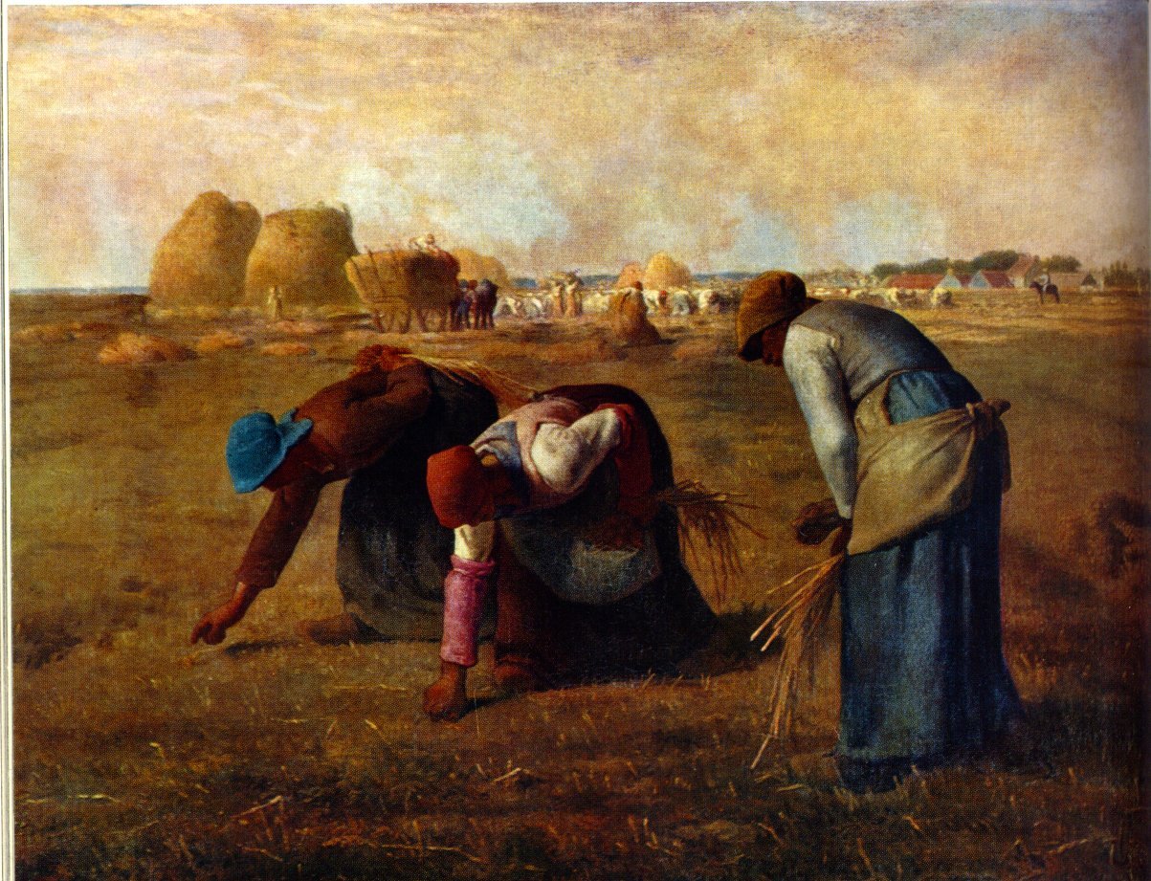
Ways of Presenting the Subject
Realism
the objects are depicted in the way they would normally appear in nature.
Abstraction
does not show the subject at all as an objective reality but only an idea of it or the feeling about it.
A technique of simplifying and reorganizing objects and elements according to the artist’s creative expressions.
The original objects have been reduced to simple geometric shapes and they can be rarely identified unless the artist named them in his/her title.

Slide 26
Abstraction does not show the subject at all as an objective reality but only an idea of it or the feeling about it. A technique of simplifying and reorganizing objects and elements according to the artist’s creative expressions. The original objects have been reduced to simple geometric shapes and they can be rarely identified unless the artist named them in his/her title.

Slide 27
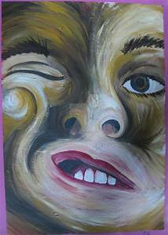
Ways of Presenting the Subject
Distortion
A technique employed by the artist to dramatize the shape of a figure in order to create an emotional effect.
Twisting, stretching, or deforming the natural form and shape of the object, e.g., caricatures.
Distorted Faces 03
124K (1 Today)
BY Doryfoo |

Slide 28
Kinds of Subjects
1. Landscapes, seascapes and cityscapes.
2. Still Life
3. Animals
4. Portraits
5. Figures
6. Everyday Life
7. History and Legend
8. Religion and mythology
9. Dreams and fantasies

Slide 29
Assignment
There are 9 Kinds of Subjects and 3 Ways of Representation. Your assignment is to give 3 examples for
each of the 9 kinds of subjects. The examples are in the form of images of paintings downloaded from the Internet.
The examples should include all the 3 ways of representation. So the 1st example is realism, 2nd abstraction and
3rd distortion. I have downloaded a sample format in our files. Include the title and artist of your examples. Submission is still through Assigments like your first assignment. (online and text format).
Kinds of subject | realism | abstraction | distortion
1.
2.
3.
4.
5.
6.
7.
8.
9.

Slide 31
Thank you so much.
Any questions?

