Slide 1
Art: its meaning and importance

Slide 2
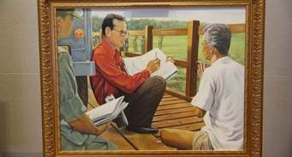
The Nature of Art
Art is Everywhere

Slide 3
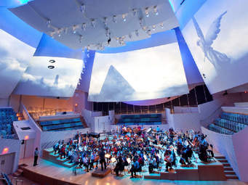
The popular feeling about art is that it exists only in concert halls museums , and art galleries in a wrld by itself, accessible only to those who can afford to pay for its enjoyment or to the critics and scholars who take time to study the art objects.
On the contrary, art is found everywhere. It is very much a part of our lives.
We cannot ignore its presence even if we try to.

Slide 4
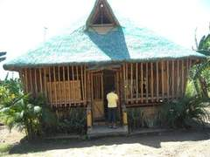
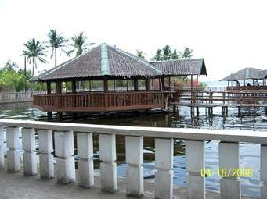
We find art in the clothes and accessories we wear, in the design of our future and furnishings, in the style of the houses we build and the vehicles we use.
We find art objects in the home and
in the community, in reigion, in trade and in industry

Slide 6
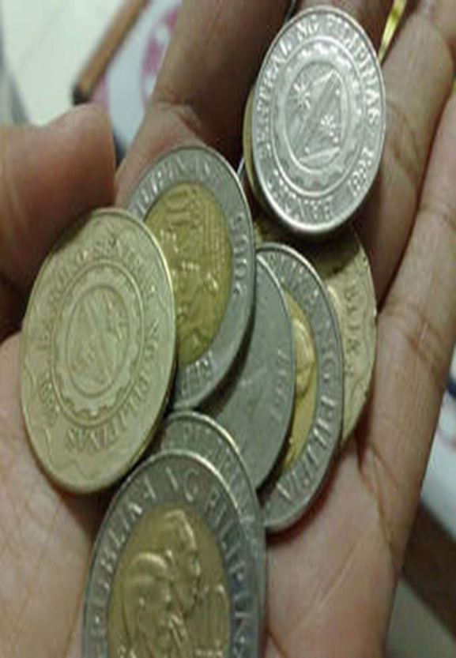
The coins we pay to the jeepney driver, as well as the religious medal we wear on a chain around our neck – these are examples of relief sculpture.

Slide 7
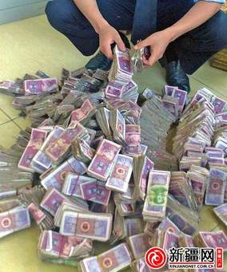
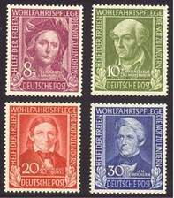
Our paper bills and postage stamps are examples of engraving. The statues of angels and saints in our churches and cemeteries are freestanding sculpture.

Slide 8
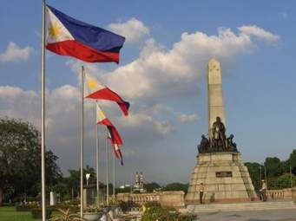
And the multicolored designs on the sides of and inside a jeepney are examples of decorative patterns. In every town plaza we see a monument of some hero, a fountain, or a consciously laid out garden

Slide 9
The buildings we pass by on our way to school and our school buildings themselves are examples of architecture

Slide 10
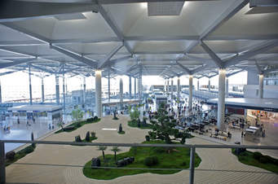
All these things are part of man’s effort to lessen the drabness and tedium of everyday living and to transform his environment into a more interesting place to live in.

Slide 12
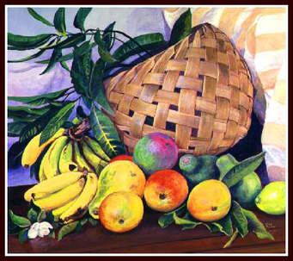
We may go further with out list – we cannot miss the paintings of fruits, flowers, sunsets, vendors and busy streets hung for sale or hawked by vendors along equally busy streets.

Slide 13
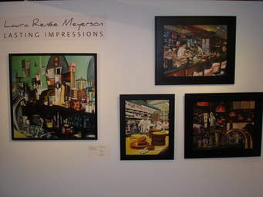
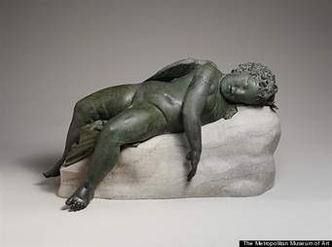
Neither can we ignore the landscapes on ice cream carts or on the walls of narrow downtown restaurants. And then every day, too, we hear of art exhibits in some art gallery or of recitals in a school auditorium.

Slide 14
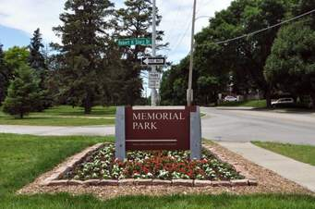
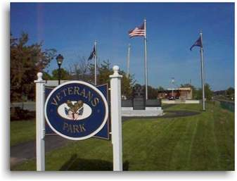
Memorial parks, too, compete with one another in the number and kind of sculptures they commission for use in their landscaping

Slide 17
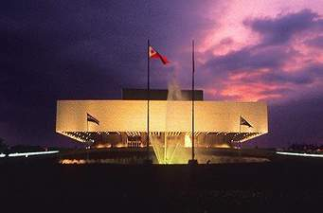
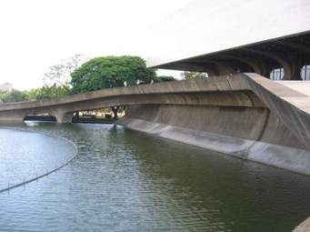
Almost every week we read notices about theatrical performances at the Cultural Center of the Philippines or some other theaters and auditoriums.
We also have occasional plays and other stage presentations in campuses.

Slide 18
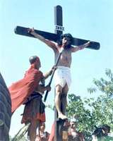
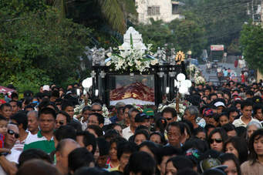
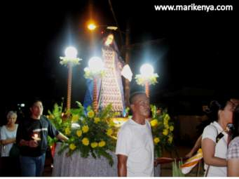
Every year we look forward to the pabasa and cenaculo during the Holy Week and above everything, there are moviehouses, everywhere, for, after music, the cinema is the art form that we enjoy most nowadays.

Slide 19
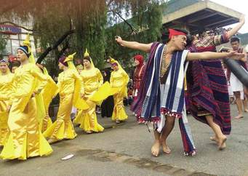
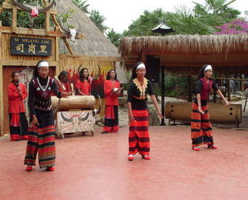
Art is not confined to our cities and towns alone; it also exists among ethnic groups, many of whom, by choice or necessity, live far away from urban centers.

Slide 20
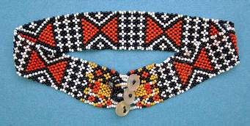
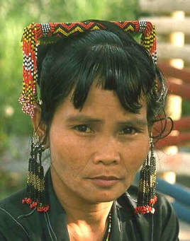
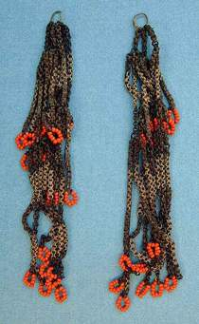
T’boli women have been stringing colorful bead necklaces and wearing them for generations.

Slide 21
The brightly colored Lepanto cloth that our dress designers rave so much about comes from the handlooms of the women of the Mountain Province.

Slide 22
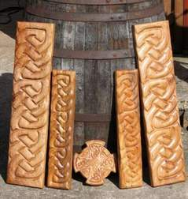
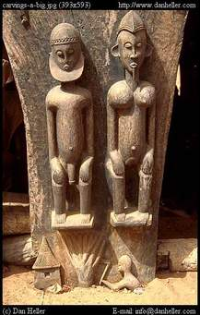
Some of the finest wood sculptures we see in many souvenir shops today have been made by Ifugao woodcarvers whose deft hands have also carved the images of thier ancestral spirits that keep constant watch over their homes and granaries

Slide 23
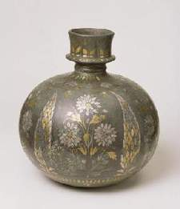
The Maranaws are noted for their exquisite metalwork – kris handles, vases, bowls, and trays engraved with intricate floral and geometric designs.

Slide 24
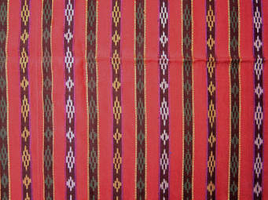
Their women wear colorful handwoven malong and delicately handcrafted jewelry

Slide 25
And their houses, decorated with ornamental abstractions, are interestig works of art themselves.

Slide 26
One must not overlook the music and dances of the Bagobos, Manobos, Tinguians, Mangyans, and other ethnic groups.
These are very much a part of their religious rituals and social functions.

Slide 27
bagobo shield

Slide 28
We find art at all times. If we go back in time to the prehistoric cave dwellers, we would find art as an integral part of their communal lives.
Evidences of early man’s attempt to objectify his ideas and beliefs are found in the paintings of animals on the walls of caves in soutwestern France and northern Spain, as well as in Africa and Australia.
Archaeological diggings in various parts of the world have unearthed clay statuettes of fertility goddesses and ppieces of bone, ivory and horn incised with images and animals.
All these date back to antiquity.
Art is indeed as old as the human race itself.

Slide 29
How can we account for this universal presence of art?
Art exists in all forms of human society and in every generation because it serves some fundamental human needs

Slide 30
½ cw /copy and answer
Why is art found in human societies? What basic needs does it meet?
what are some of the thoughts that man conveys through his art? Give examples of works of art that show these?
How does Humanities and art connect the development of man? Discuss
Explain this: Art is indeed as old as the human race itself.

Slide 31
½ copy and answer
How does Humanities and art connect the development of man? Discuss
Explain this: Art is indeed as old as the human race itself.

