Slide 1
HUMANITIES

Slide 2
What am i?
Why am I in this world?
Where do I go from here?
who am i?

Slide 3
Man is puzzled over the meaning of his existence

Slide 4
We learn what it is to be human by studying humanity.
This encounter is made possible for us in the humanities.

Slide 5
HUMANITIES
Generally refers to:

Slide 6
ART

Slide 7
LITERATURE

Slide 8
MUSIC

Slide 9
ARCHITECTURE

Slide 10
DANCES

Slide 11
THEATRE

Slide 12
These areas in which human subjectivity is emphasized and individual expressiveness is dramatized.
-The records of human experiences, his/her values, sentiments, ideas and goals.
-Ultimately the expressions of human feelings and thoughts.

Slide 13
During the renaissance, humanities was referred to the set of disciplines taught in the universities, which included grammar, rhetoric, history, literature, music and philosophy
– a body of knowledge aimed to make a human person a full person, i.e., cultured, refined and well-rounded.

Slide 14
The humanities thus provide more than just an appreciation of what is :the true, the good, and the beautiful,” concepts which vary from age to age, from country to country.
They are aimed to shape the student’s subjective energies (feelings, attitudes, and aspirations) in accordance with a particular view of the social world in which he dreams, acts and fulfills himself.
The view about human and his world changes and so too the content and direction of humanities;
But in all cases, their principal task remains the same, which is to make an conscious and critical of, and sensitive and responsive to the norms and hopes of society.

Slide 15
HUMANITIES AND SOCIAL SCIENCES
HUMANITIES | SOCIAL SCIENCES
Person as an Individual | Types and groups of people, institutions and processes of society
Internal world of the human person (personality, experiences, thoughts and feelings) | External world of people (social relations etc.)
Nature of study: generally subjective e.g., use of perception, feelings, intuition, insights | Scientific, generally objective, subject to observation, measurement and experimentation.

Slide 16
HISTORICAL DEVELOPMENT
Medieval Period (12th-14th Centuries)
Medieval universities/professors were interested in metaphysics and religious things (scholasticism) whose goal was the cultivation of spiritual life and preparations for the hereafter.
Ancient Period:
Humanities were writings about the moral teachings by Latin writers and philosophers

Slide 17
HISTORICAL DEVELOPMENT
Modern/Contemporary
The rise of sciences (social sciences) affected or stunted the further development of humanities as a free and encompassing discipline.
People’s thoughts, feeling, expressions, mediums, were overshadowed by scientific formula and systems.
Renaissance Period (15th – 18th Centuries)
Humanities were disciplines in schools and universities which focused and asserted the intrinsic value of human life on earth, his/her essential worth and capacity for self-advancement in this world. Thus, it included Greek literatures, fine arts, music, history, theology, philosophy and rhetoric.

Slide 18
ARTS: Meaning and Nature
Constitute one of the oldest and most important means of expressions developed by people.
Art has been created by people at all times, it lives because its liked and enjoyed.
It involves personal experience of an individual accompanied by some intensity of emotions.

Slide 19
Works of art reflect also the milieu an artist belongs and therefore is not free from the influences of his/her social, economic, political, cultural, geographic, scientific, and technological environment.
Appreciating a work of art implies an intellectual involvement with what is to be appreciated.
Art is a product of people’s needs to express himself and is not limited to the emotions alone.

Slide 20
The Functions of Art
To find meaning in art, it must serve a utilitarian purpose and be capable of serving the purpose for which it was designed.

Slide 21
The Social Functions of Art
Influences collective behavior or people for a cause.
Social behavior is influenced by many works of art.
Advertisements: greatly influence the social behavior of an individual especially their tastes and preferences.

Slide 22
Physical Functions
Many works of art were primarily made to perform certain functions to make our lives comfortable.
Music and its Function
Music which is the art of combining and regulating sounds of varying pitch to produce compositions expressive of various ideas and emotions that are pleasing are basically functional.
The two sources of music in its origin are dances and religion.
Sculpture and its Function
Sculpture which is the art of carving, molding or producing works of art in three dimensions, as in relief, or in intaglio, is more functional than painting and literature. Examples: religion and its churches, coins, icons, monuments and others.

Slide 23
Two Schools of Thought in Arts
Artists who believe solely in “arts for the sake of arts”, or arts as plain aesthetics and individual satisfaction.
Basic beliefs and values:
There is need to contribute to make it desirable and convenient place to live.
Choice of subjects: natural objects (flowers, rivers, physical bodies, mountains, trees, etc)
Content: serenity, purity, stability, harmony, etc.
Forms: from indigenous to expensive materials
Style: surrealism, abstract and realism
The world/society is stable and in harmony and therefore should not be shaken.

Slide 24
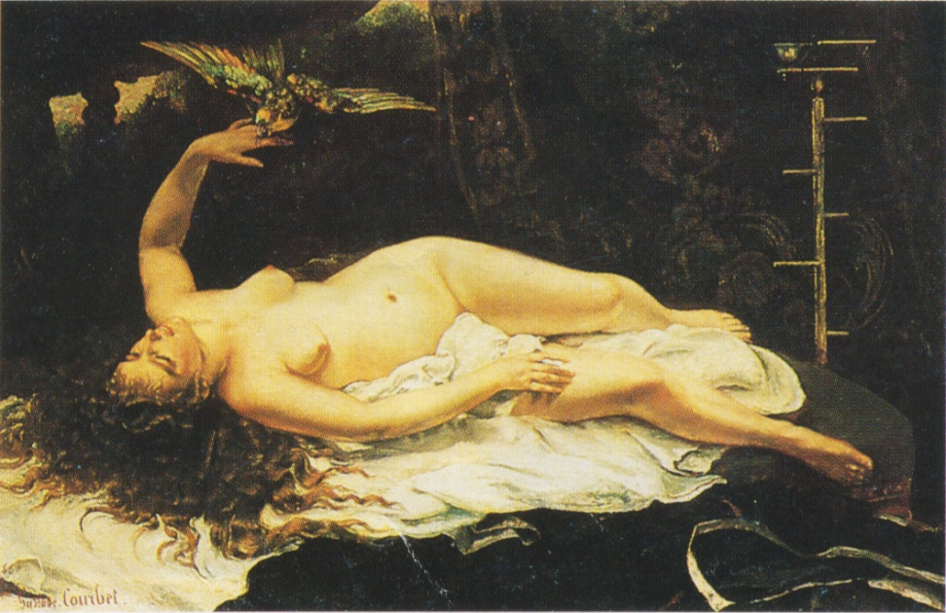
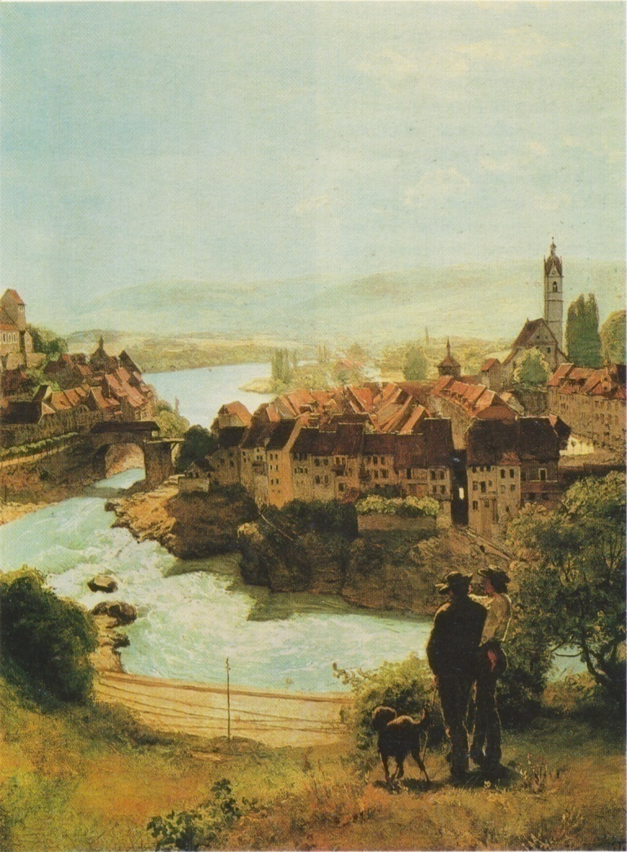

Slide 25
Artists who believe in arts as medium or instrument of social change, e.g., depicting social realities and advocating for a change or reforms.
Basic beliefs and values:
Choice of subjects: social issues
Content: injustice, oppression, exploitation, etc.
Form: indigenous materials
Style: social realism, surrealism
The world/society is changing and in conflict. There is a need to change it and make it prosperous and equitable.

Slide 26
The Subject of Art
The subject of art is varied. It may refer to any person, object, scene, or even represented in a work of art.
Representational Art
Arts that have subjects e.g., painting, sculpture, graphic arts, literature, theatre and others.
Non-Representational Art
Arts that do not have subjects, e.g., music, architecture, and many functional arts.
Do not present descriptions, stories or references to identifiable objects or symbols.
They appeal directly to the senses primarily because of the satisfying organization of their expressive elements.

Slide 27
Ways of Presenting the Subject
Realism
the objects are depicted in the way they would normally appear in nature.
Abstraction
does not show the subject at all as an objective reality but only an idea of it or the feeling about it.
A technique of simplifying and reorganizing objects and elements according to the artist’s creative expressions.
The original objects have been reduced to simple geometric shapes and they can be rarely identified unless the artist named them in his/her title.

Slide 28
Ways of Presenting the Subject
Distortion
A technique employed by the artist to dramatize the shape of a figure in order to create an emotional effect.
Twisting, stretching, or deforming the natural form and shape of the object, e.g., caricatures.
Surrealism
A combination of realism and distortion

